Slide 1
Hidden in Plain Sight
Enhance Dapps with Fully Homomorphic Encryption
Sunscreen

Slide 2
Hidden in Plain Sight
Gather source material
Design our game
Fully homomorphic encryption
Sunscreen FHE compiler
Build our game with Sunscreen
Sunscreen

Slide 3

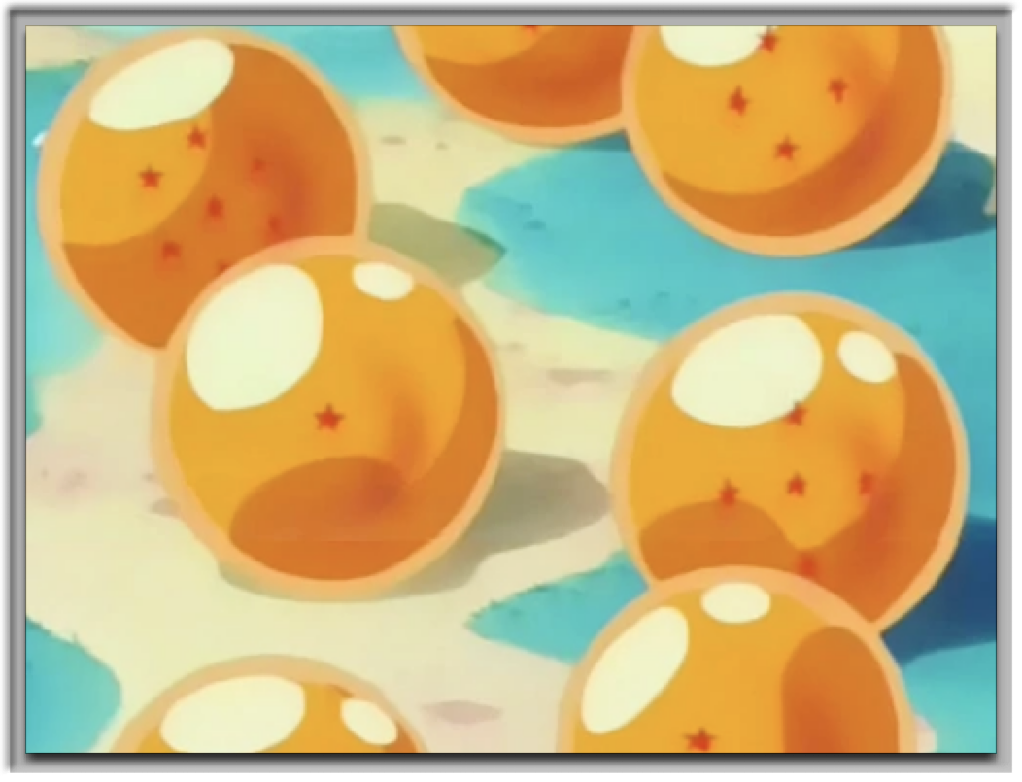
Sunscreen

Slide 4
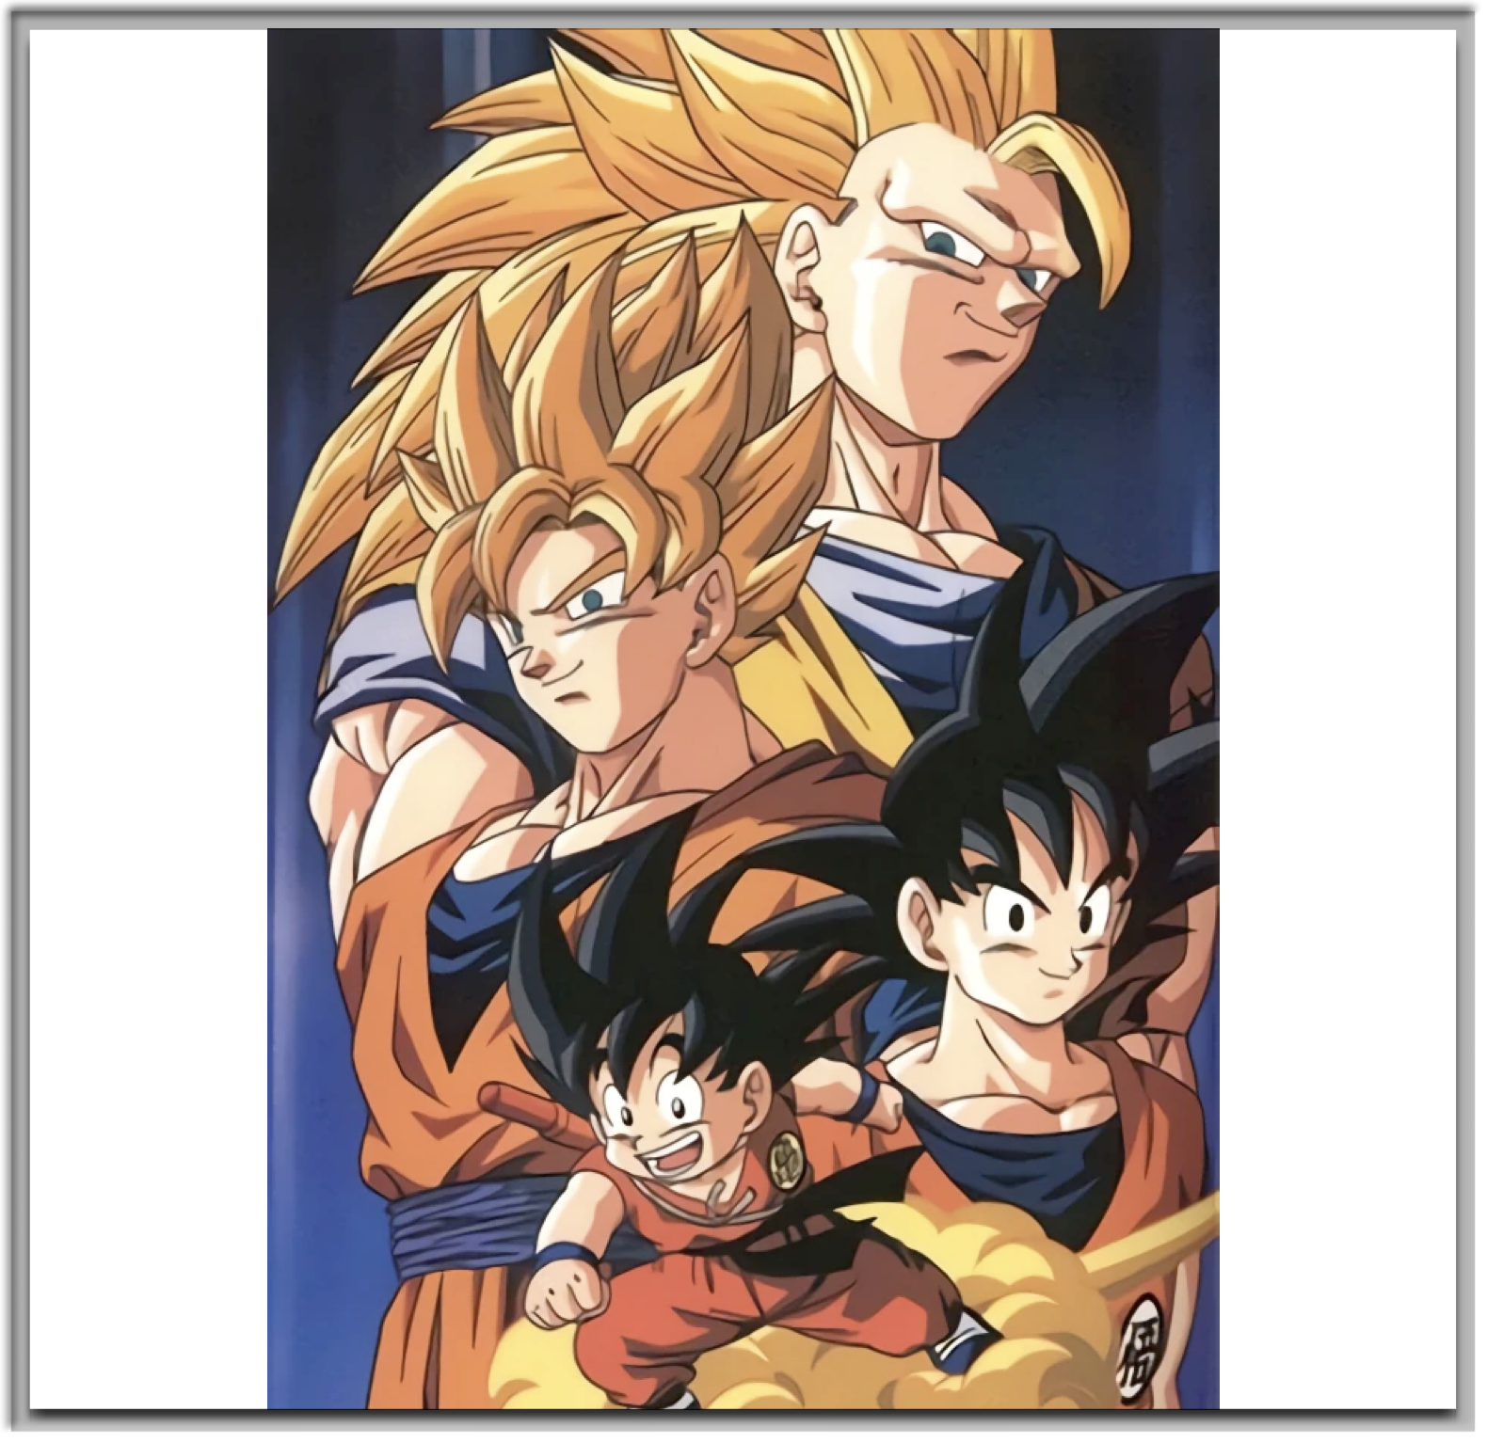

Exponential growth
Case study: Goku’s power level
Raditz saga: 416
Vegeta saga: It’s over 9000!
Frieza saga: 3,000,000
Super Saiyan: 150,000,000
Sunscreen

Slide 5

Hide your power level
Avoid detection
Surprise your enemies in battle
Sunscreen

Slide 6
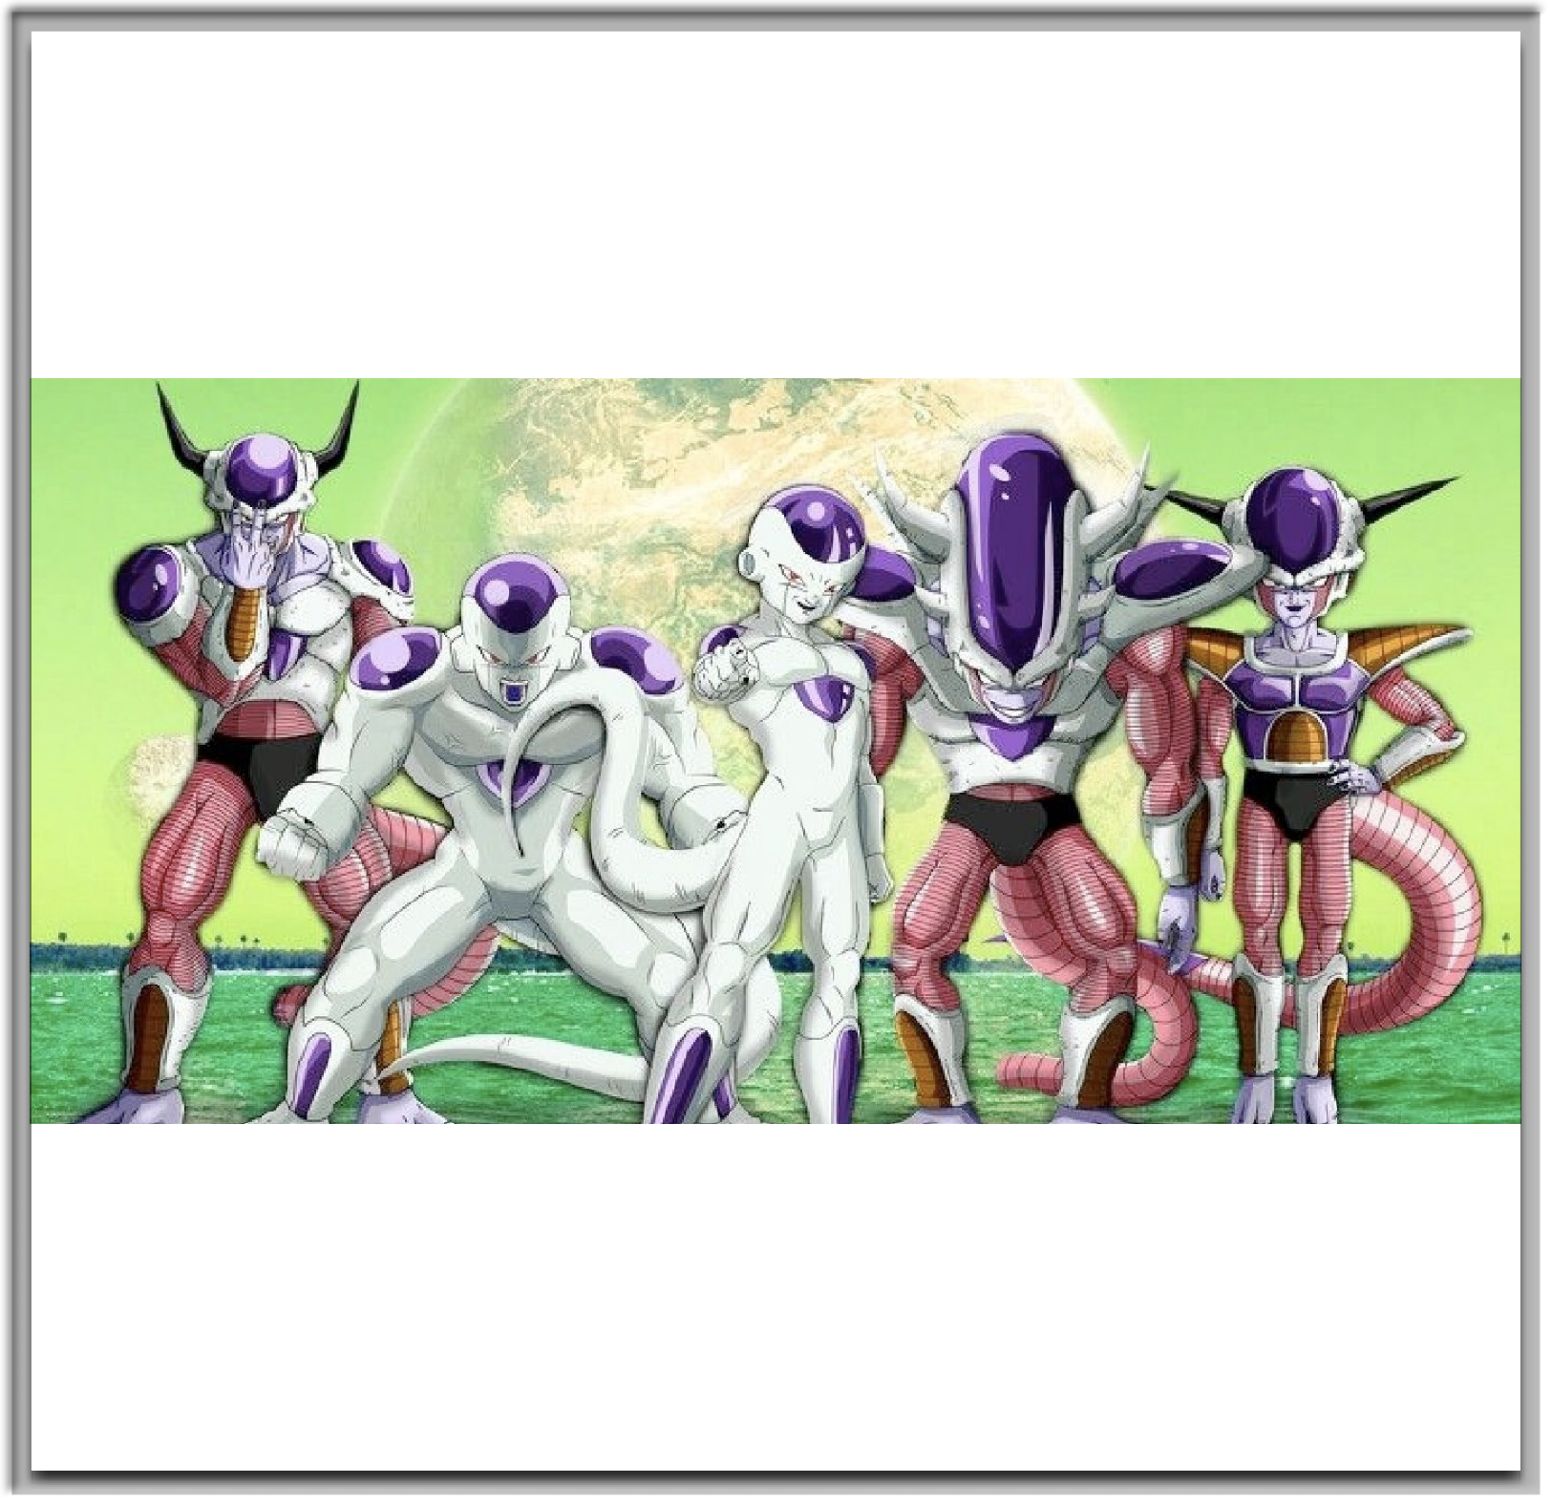
This is not my final form
Just when you think they’re dead…
Sunscreen

Slide 7
Hidden in Plain Sight
Gather source material
Design our game
Fully homomorphic encryption
Sunscreen FHE compiler
Build our game with Sunscreen
Sunscreen

Slide 8
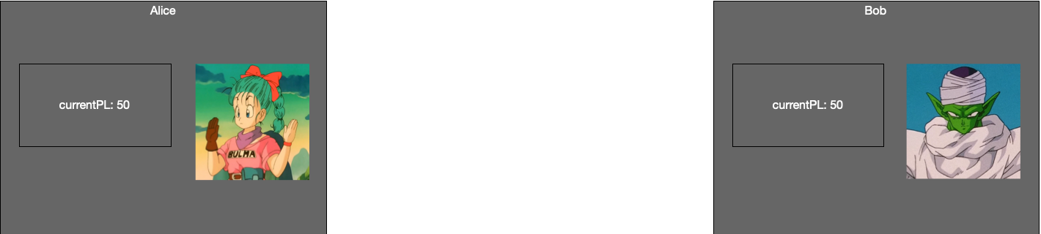
Alice and Bob Super Battle
Sunscreen

Slide 9
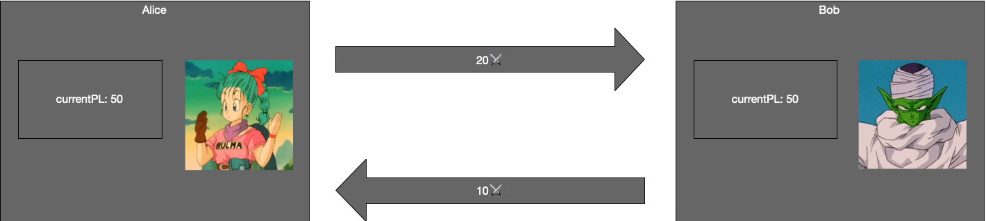
Alice and Bob Super Battle
Sunscreen

Slide 10
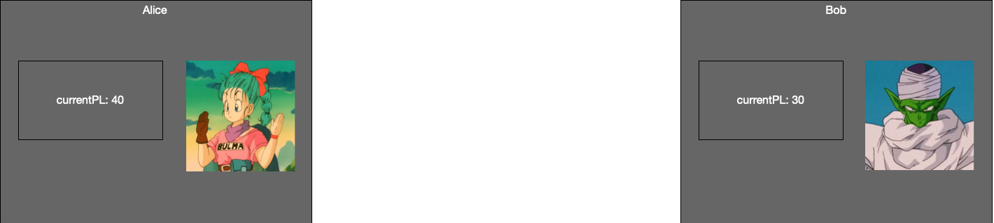
Alice and Bob Super Battle
Sunscreen

Slide 11
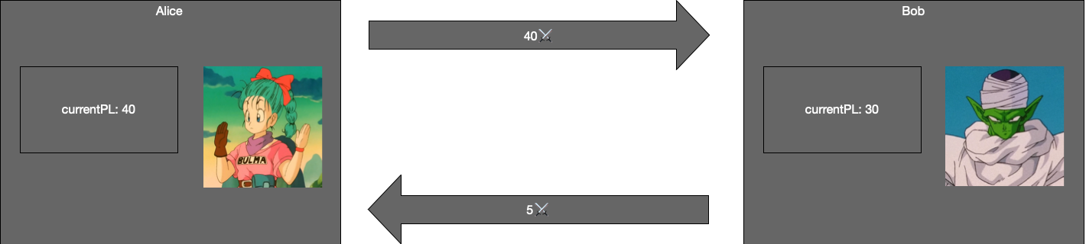
Alice and Bob Super Battle
Sunscreen

Slide 12
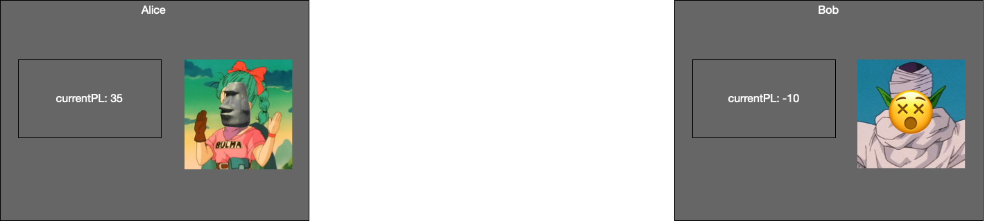
Alice and Bob Super Battle
Sunscreen

Slide 13
This game sucks
Sunscreen

Slide 14

Alice and Bob Stupid Battle
Sunscreen

Slide 15

Alice and Bob Stupid Battle
Sunscreen

Slide 16
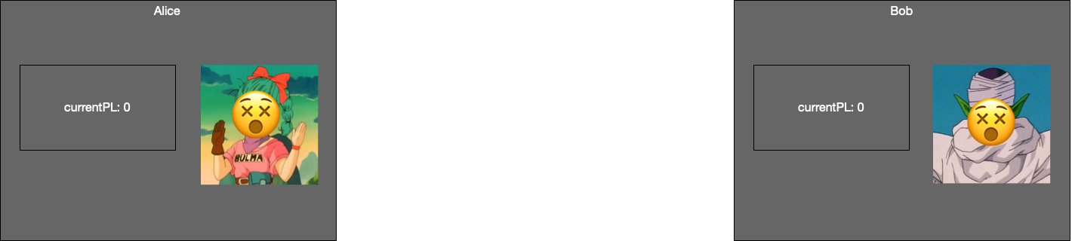
Alice and Bob Stupid Battle
Sunscreen

Slide 17
Improve the game
Hide your power level
Encrypt all power level stats
Choose 0 < playPL ≤ totalPL at start of battle
Initialize currentPL to playPL
This is not my final form
If currentPL < -10, reset currentPL to playPL
Exponential growth
On victory: totalPL = ( totalPL - playPL )^2
Sunscreen

Slide 18
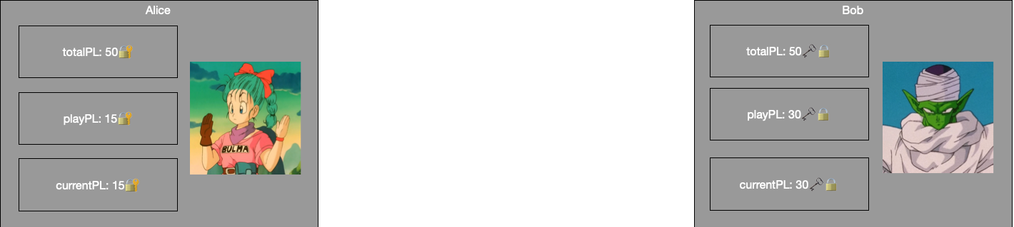
Alice and Bob Super Battle
Sunscreen

Slide 19
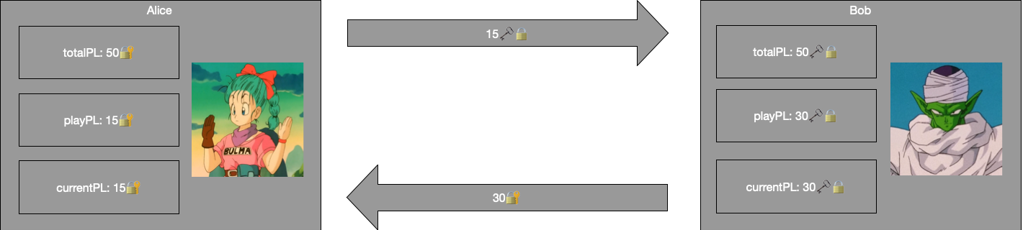
Alice and Bob Super Battle: attacking
Sunscreen

Slide 20
Alice and Bob Super Battle: attacking
☝️ ☝️
How do you subtract these without decrypting…
Sunscreen

Slide 21
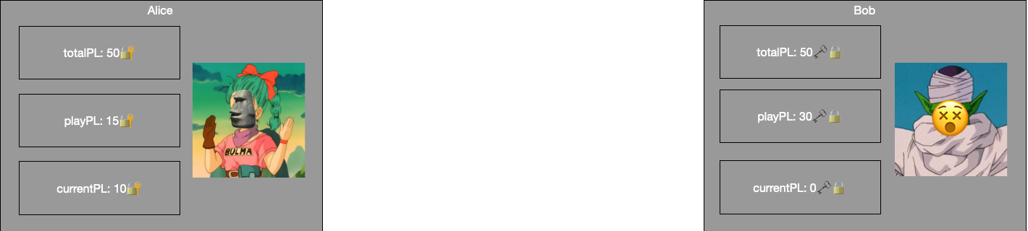
Alice and Bob Super Battle: level up
1225🔐
totalPL = ( totalPL – playPL )^2
…much less compute this equation?☝️
Sunscreen

Slide 22
Hidden in Plain Sight
Gather source material
Design our game
Fully homomorphic encryption
Sunscreen FHE compiler
Build our game with Sunscreen
Sunscreen

Slide 23
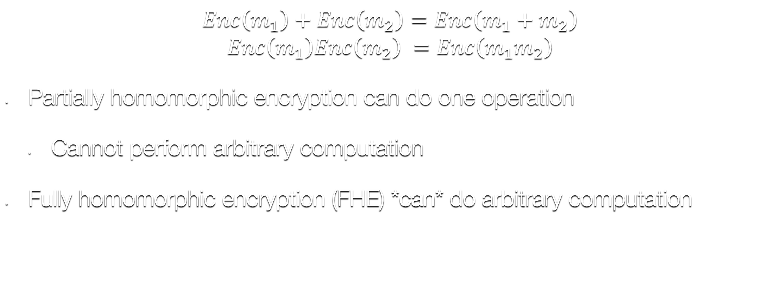
Homomorphic encryption
$$Enc\left(m_{1}\right)+Enc\left(m_{2}\right)=Enc\left(m_{1}+m_{2}\right)$$
$$Enc\left(m_{1}\right)Enc\left(m_{2}\right) =Enc\left(m_{1}m_{2}\right)$$
Partially homomorphic encryption can do one operation
Cannot perform arbitrary computation
Fully homomorphic encryption (FHE) *can* do arbitrary computation
Sunscreen

Slide 24
FHE
Today’s schemes based on lattice problems
Post-quantum
Leveled schemes can perform finite number of computations
Bootstrapping allows for unlimited computation
Time+space requirements satisfied by a modern smartphone
Sunscreen

Slide 25

Our scheme of choice
Scheme | BFV
Implementation | SEAL
Plaintexts | $$ℤ_{p}\left[x\right]/(x^{d}+1)$$
Exact arithmetic? | ✅
64-bit integer multiply speed | ~17 ms
Sunscreen
Notes:
Explain Microsoft SEAL is library that supports a few FHE schemes including BFV
Mention “some schemes are approximate”

Slide 26
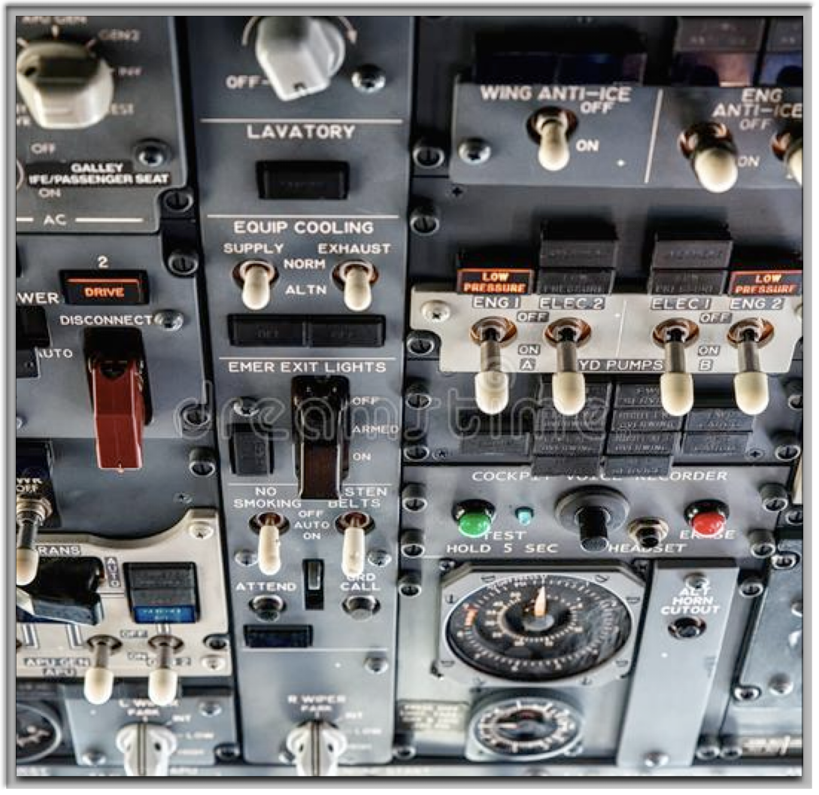
FHE is hard
Scheme parameters that impact
Noise tolerance
Time and space
Sunscreen

Slide 27
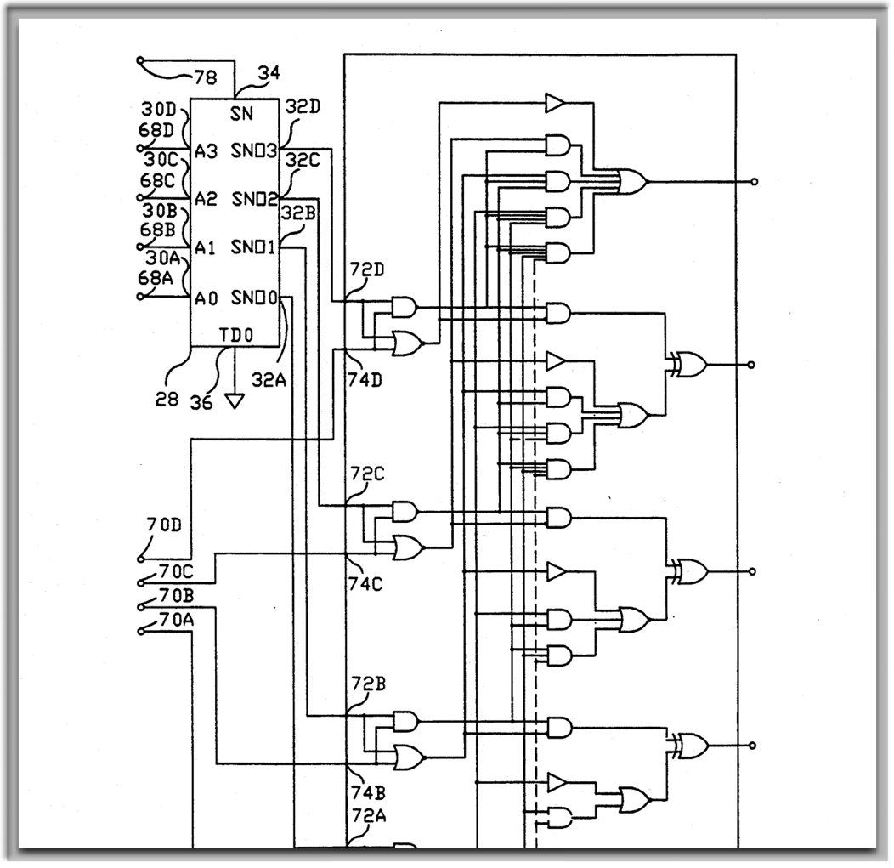
FHE is hard
Circuit execution model
No branching!
Ciphertext maintenance operations
Relinearization
Sunscreen

Slide 28
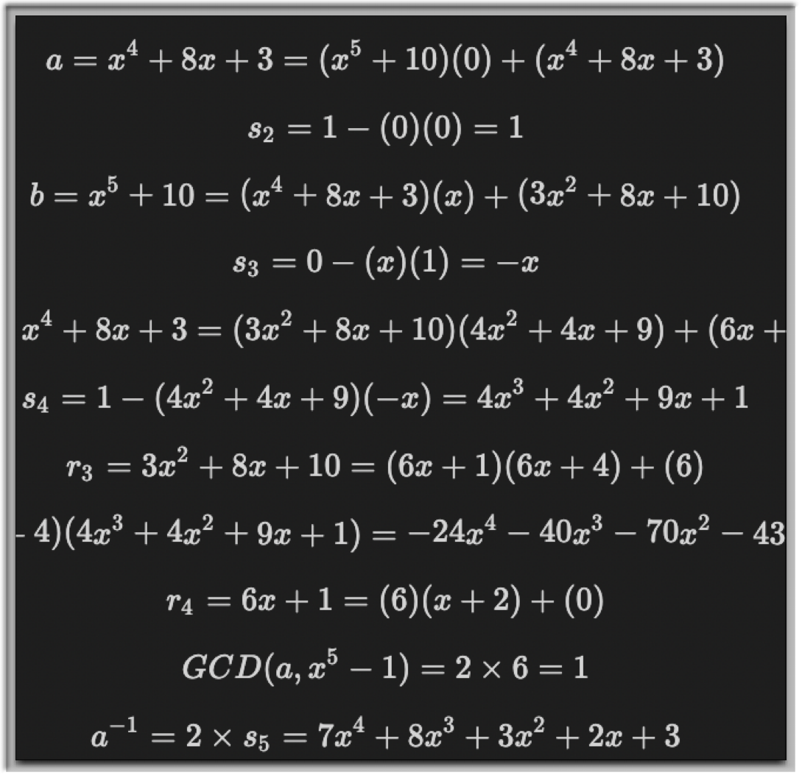
FHE is hard
Polynomials annoying to work with
Integers?
Fixed point?
Sunscreen

Slide 29
Hidden in Plain Sight
Gather source material
Design our game
Fully homomorphic encryption
Sunscreen FHE compiler
Build our game with Sunscreen
Sunscreen

Slide 30
Sunscreen
Sunscreen is
FHE program DSL
compiler
runtime
Sunscreen

Slide 31
FHE programs
Rust function with special macro
Arbitrary # arguments
Single or multiple return values (via tuple)
Encrypted (Cipher<T>) or plaintext arguments
Types!
Some restrictions apply
#[fhe_program(scheme = "bfv")]
fn hello(
a: Cipher<Signed>,
b: Cipher<Signed>,
) -> (Cipher<Signed>, Cipher<Signed>) {
(a + b, a * a)
}
Sunscreen

Slide 32
Compiler
Builds an arithmetic circuit from your function
Chooses parameters: maximize speed while maintaining correctness
Inserts relinearizaton operations
let fhe_program = Compiler::with_fhe_program(hello)
.compile()?;
Sunscreen

Slide 33
Runtime
Generate keys
Encryption/decryption
Encoding/decoding
Run FHE programs
let runtime = Runtime::new(&fhe_program.metadata.params)?;
let (public_key, private_key) = runtime.generate_keys()?;
let a = Signed::from(6);
let a_c = runtime.encrypt(a, &public_key)?;
let b = Signed::from(3);
let b_c = runtime.encrypt(b, &public_key)?;
let args: Vec<FheProgramInput> = vec![a_c.into(), b_c.into()];
let result = runtime.run(&fhe_program, args, &public_key).unwrap();
Sunscreen

Slide 34
Hidden in Plain Sight
Gather source material
Design our game
Fully homomorphic encryption
Sunscreen FHE compiler
Build our game with Sunscreen
Sunscreen

Slide 35
Alice and Bob Super Battle
Sunscreen

Slide 36
Alice and Bob Super Battle
Sunscreen

Slide 37
Alice and Bob Super Battle
☝️ ☝️
Homomorphic addition!
Sunscreen

Slide 38

Alice and Bob Super Battle
☝️ < -10 currentPL: Alice is reborn
Sunscreen

Slide 39

Alice and Bob Super Battle
Sunscreen

Slide 40
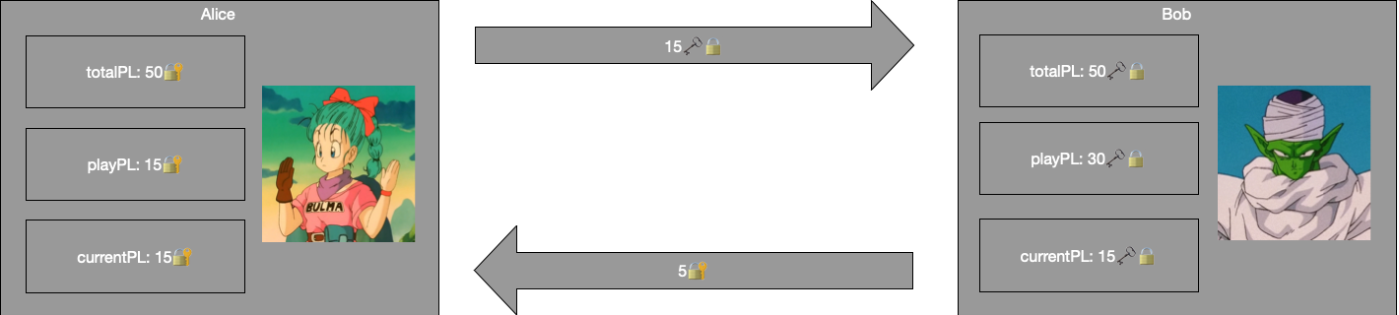
Alice and Bob Super Battle
Sunscreen

Slide 41
Alice and Bob Super Battle
Sunscreen

Slide 42
Level up: exponential growth
1225🔐
totalPL = ( totalPL – playPL )^2
Sunscreen

Slide 43
Level up: exponential growth
1225🔐
totalPL = ( totalPL – playPL )^2
Homomorphic multiplication!☝️
Sunscreen

Slide 44
Are we web3 yet?
✅ Sunscreen FHE compiler
🔜 Zero knowledge proofs for lattice relations
🔜 Integrate above into Ethereum ecosystem
🔜 Wallet to interact with chain
Sunscreen

Slide 45
Coding time
Sunscreen

Slide 46
Questions?
Github
https://github.com/Sunscreen-tech/Super-Battle
Docs
https://docs.sunscreen.tech
Playground
https://playground.sunscreen.tech
Email: rick@sunscreen.tech Twitter: @sunscreentech
Sunscreen

